Slide 2
Look at the timetable
and answer the questions.

Slide 3
SCHOOL TIMETABLE
When do we have English?
On Monday at a quarter past nine and on Friday at twenty past eight.
CHECK

Slide 4
SCHOOL TIMETABLE
When do we have maths?
On Monday at twenty past eight and on Wednesday at half-past ten
CHECK

Slide 5
SCHOOL TIMETABLE
When do we have P.E.?
On Tuesday at a quarter past nine and on Thursday at twenty-five past eleven
CHECK

Slide 6
SCHOOL TIMETABLE
When do we have art?
On Monday at twenty-five past eleven and on Friday at a quarter past nine
CHECK

Slide 7
SCHOOL TIMETABLE
When do we have literature?
On Tuesday and Thursday
at twenty past eight
CHECK

Slide 8
Which part of the school day do you like the most? Why?

Slide 9
UNIT 6
SURVIVAL
LESSON 6: WRITING
A blog

Slide 10
✔ Activity 1: Read Thanh’s blog. Who is the information in this blog for? What advice does Thanh give about school work?

Slide 11
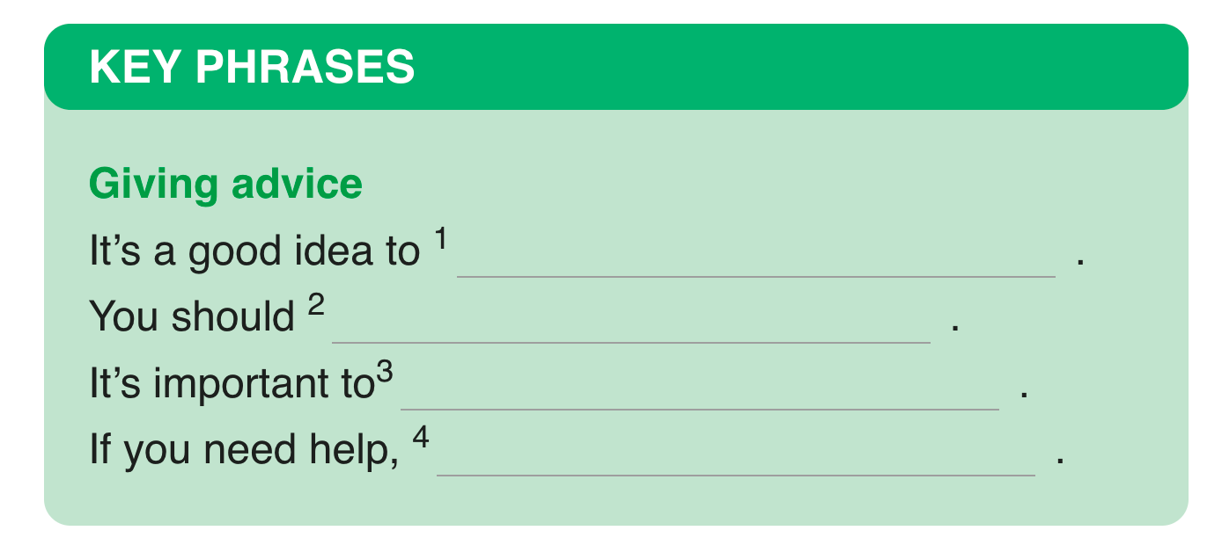
✔ Activity 2: Complete the Key Phrases with words from the blog.
join clubs
pay attention in class
arrive on time for lessons
ask your teachers

Slide 12
Language point:
Imperatives

Slide 13
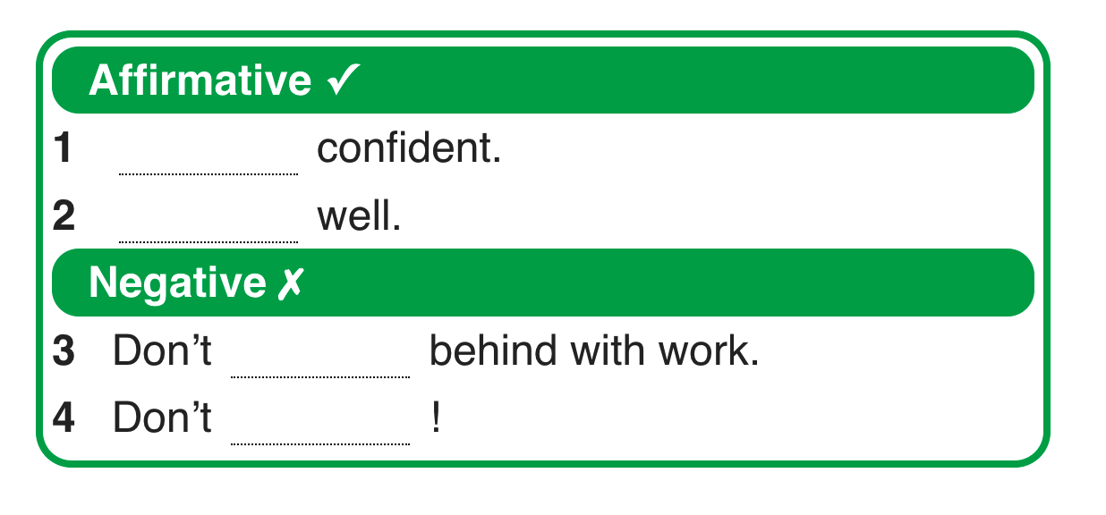
✔ Activity 3: Cover the text. Can you remember the advice? Complete the sentences. Then read the text and check your answers.
STAY
DRESS
GET
PANIC

Slide 14
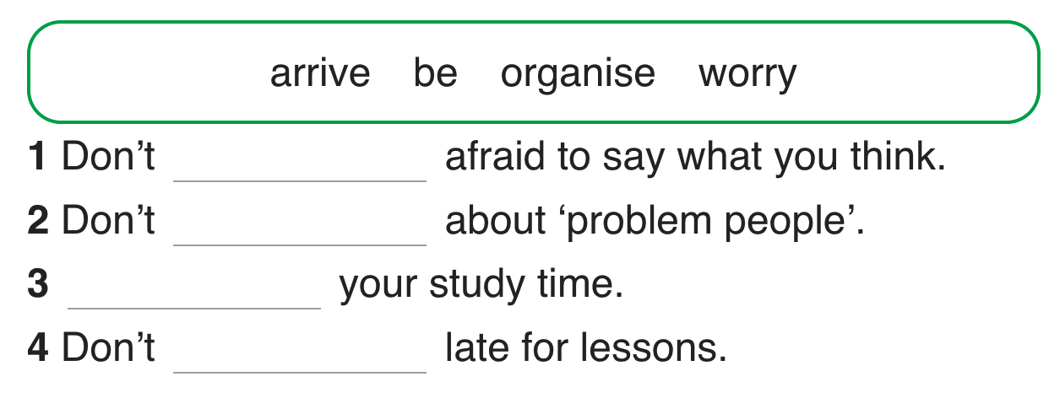
✔ Activity 4: Complete the imperative sentences with the verbs in the box.
be
worry
Organise
arrive

Slide 16
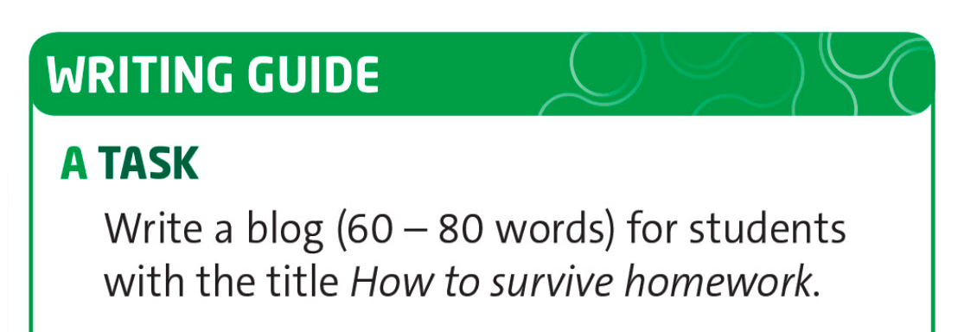
✔ Activity 5: Follow the steps in the Writing guide.

Slide 17
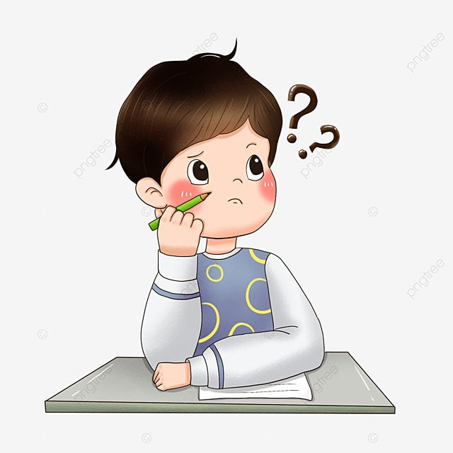
✔ Activity 5: Follow the steps in the Writing guide.
When should you do it?
What problems do students have with homework?
Where can you get help?
What can you do if it is very difficult?
What about weekend?

Slide 18
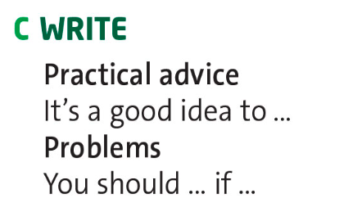
✔ Activity 5: Follow the steps in the Writing guide.
How to survive homework
Homework is … Here are my tips …
It's a good idea to …
You should … if …
Do …
Don't …
It's important to …

Slide 19
✔ Activity 5: Follow the steps in the Writing guide.
your use of imperatives
should and shouldn't
first conditional
the neatness of your report
spelling

Slide 20
- Learn by heart all the structures.
.- Workbook: Exercises p.43

